Slide 1
Intro to Data Visualization (in 🐍)
Feat. Your Tour GUIDE:
Jonathan Armoza (Origami LAB @ MCGill, English dept @ NYU)

Slide 2

WHO I Am
Background: Computer Science, English Literature & Digital Humanities, Software Engineering, Game Development, Tech Consulting, Web UI + Data Viz development
Projects assisted and/or developed: Google Books Ngram Viewer, Google ads dashboards, Voyant Tools, Topic Words in Context, Working from Scraps, Simexp QC dashboard, MIST multiscale dashboard, Neurobagel metadata tool suite, and many other digital humanities-related visualizations
10 years of data visualization development and communication
INTRODUCTION

Slide 3
Why THAT is important
Context is key
Data represents a complex world
Data is complex, selective/partial, and contingent
.... and so are data visualizations!!!
INTRODUCTION

Slide 4
Data viz ARE visual
And thus, even more subjective and ideological than the data being visualized
A picture is worth a thousand words …
INTRODUCTION

Slide 5
Data viz ARE visual
Who is visualizing data?
What data is being visualized?
How is data being visualized?
Where is data being visualized?
Who is the potential audience?
INTRODUCTION

Slide 6
Data viz ARE Rhetoric
As researchers and scientists, our goal is to be objective as possible while presenting our findings.
However, we are also implicitly and explicitly making arguments about data when we do so.
These two goals can be contradictory, but it is our job to balance them while effectively doing both.
INTRODUCTION

Slide 7
Use our imagination and intuition to most effectively communicate our data and findings to a desired audience.
INTRODUCTION

Slide 8
Who is our audience?
Journal
Poster
General public
Web
INTRODUCTION

Slide 9
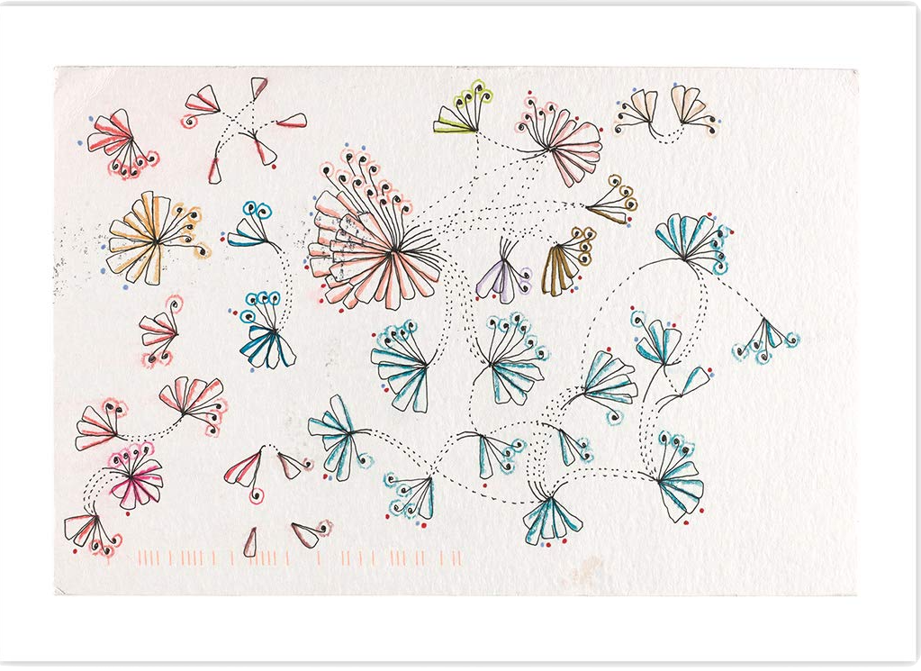
INTRODUCTION
via: dear-data.com

Slide 10
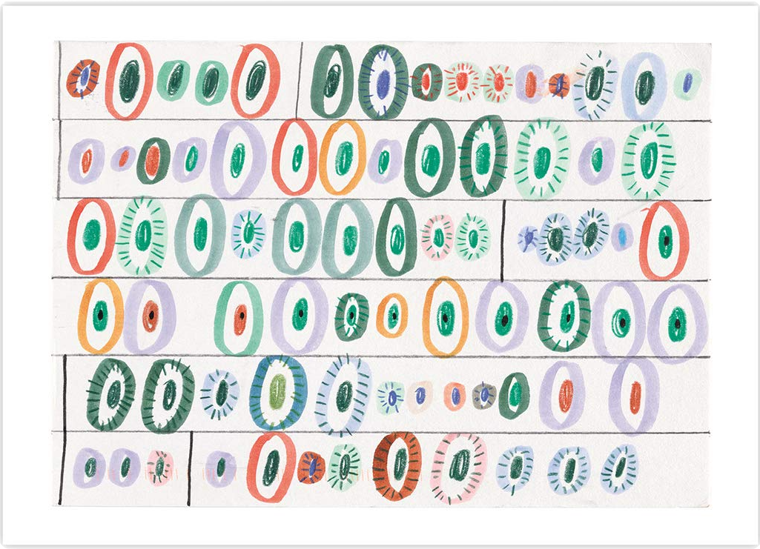
INTRODUCTION
via: dear-data.com

Slide 11
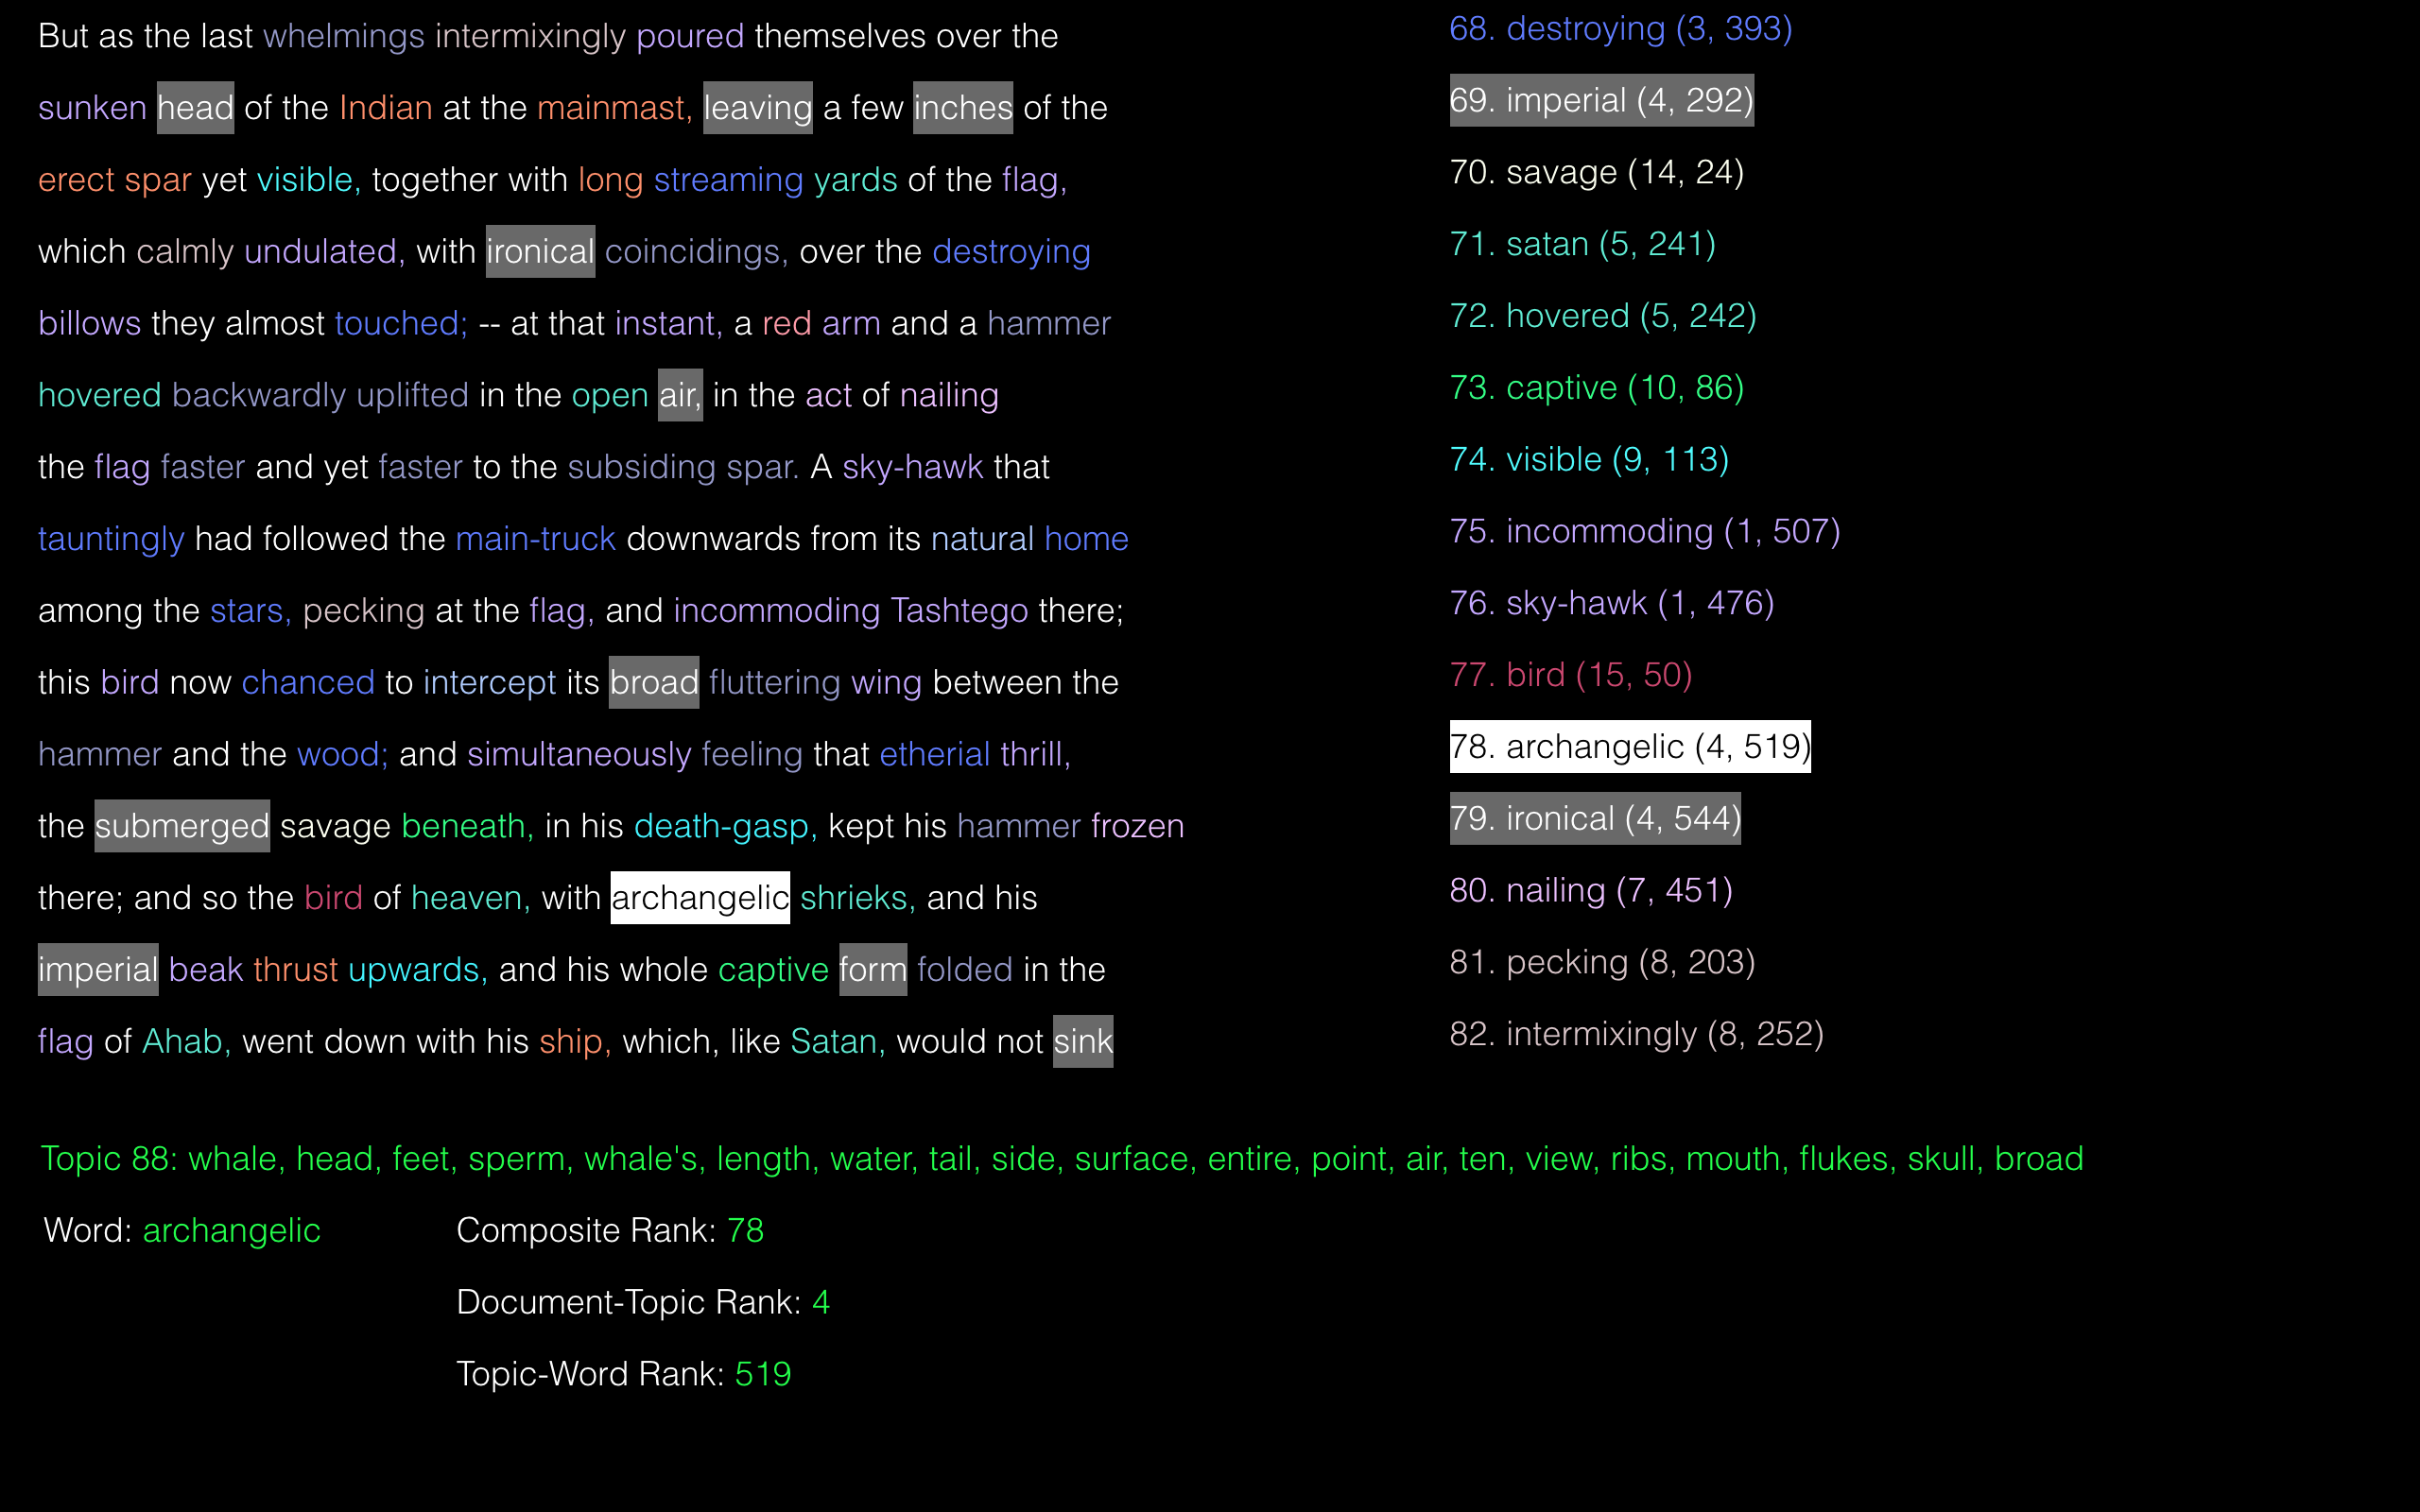
INTRODUCTION
via: github.com/jarmoza/twic_close_reading

Slide 12
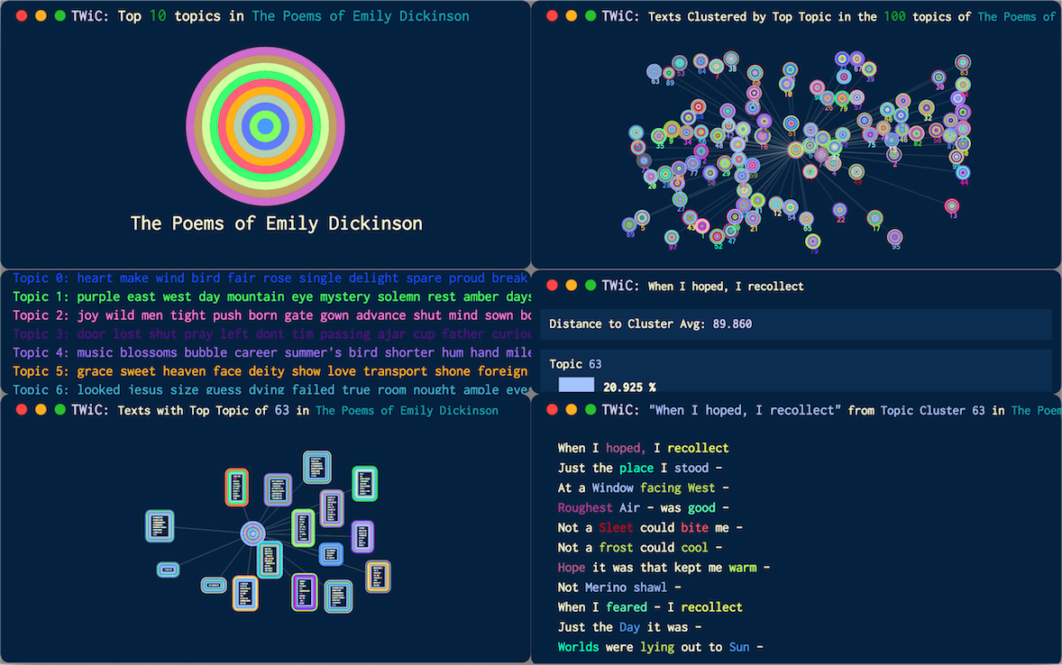
INTRODUCTION
via: github.com/jarmoza/twic2

Slide 13
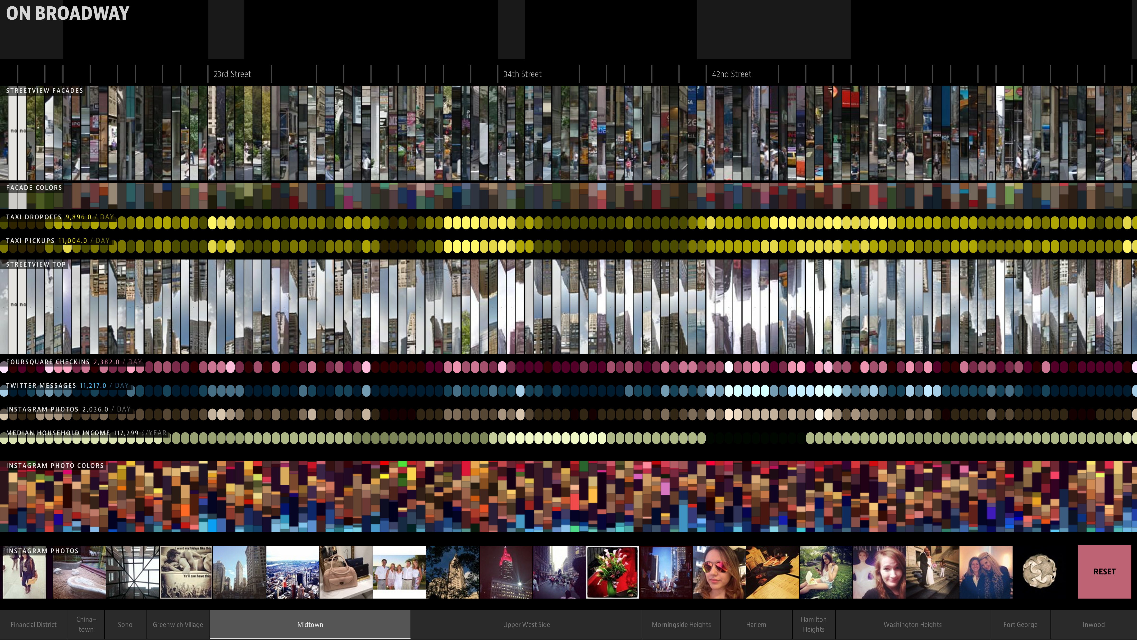
via: on-broadway.nyc

Slide 14
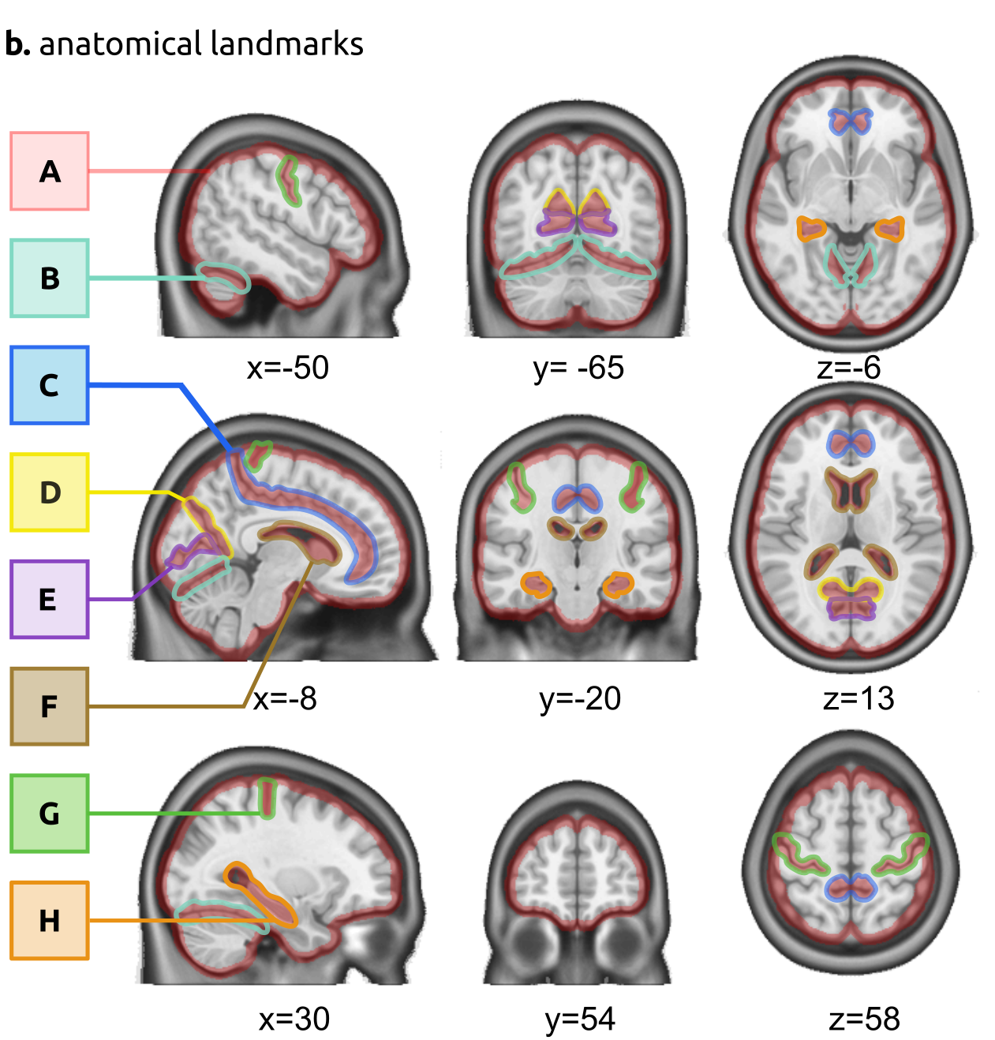
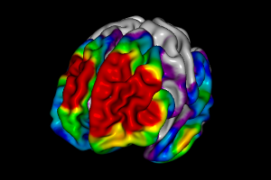
If this is what we want to do, how do we get there?
via: BrainMatch QC
via: MCIN Brainbrowser
INTRODUCTION

Slide 15
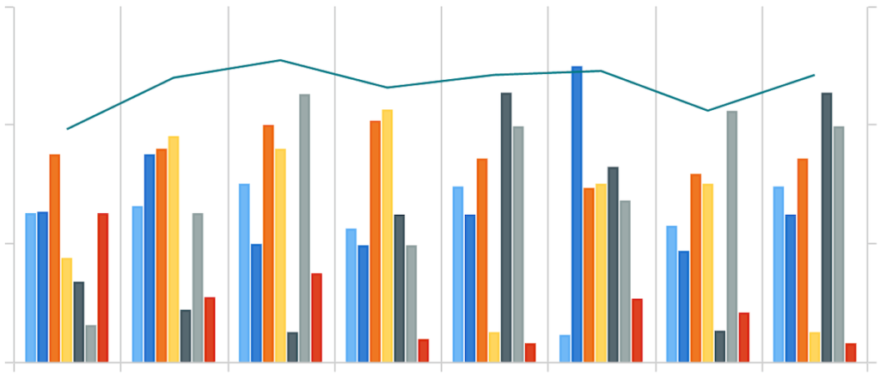
Exploring our data via basic visualization(s)
INTRODUCTION

Slide 16
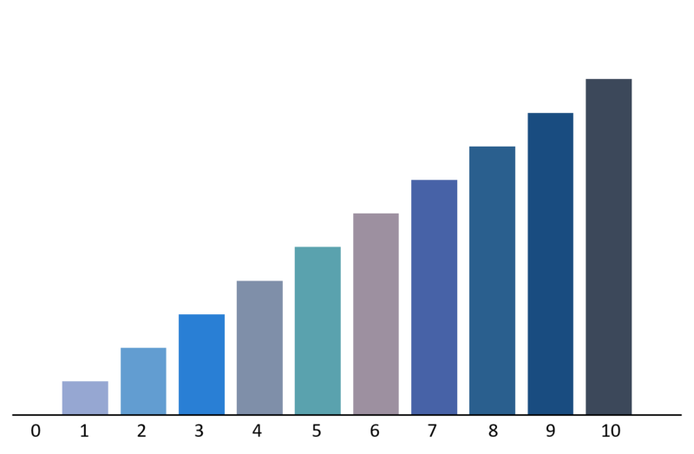
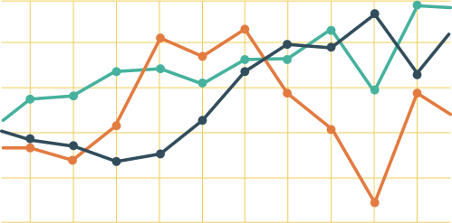
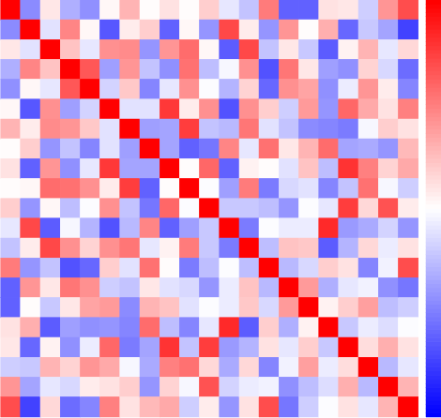
Types of visualizations
Visualization types for different types of data
i.e. scalar (discrete, continuous) and categorical (nominal, ordinal)
TYPES

Slide 17
Types of visualizations
Visualization types for different purposes
i.e. showing scale, relationships, trajectory, momentum, gradient, etc.
TYPES

Slide 18
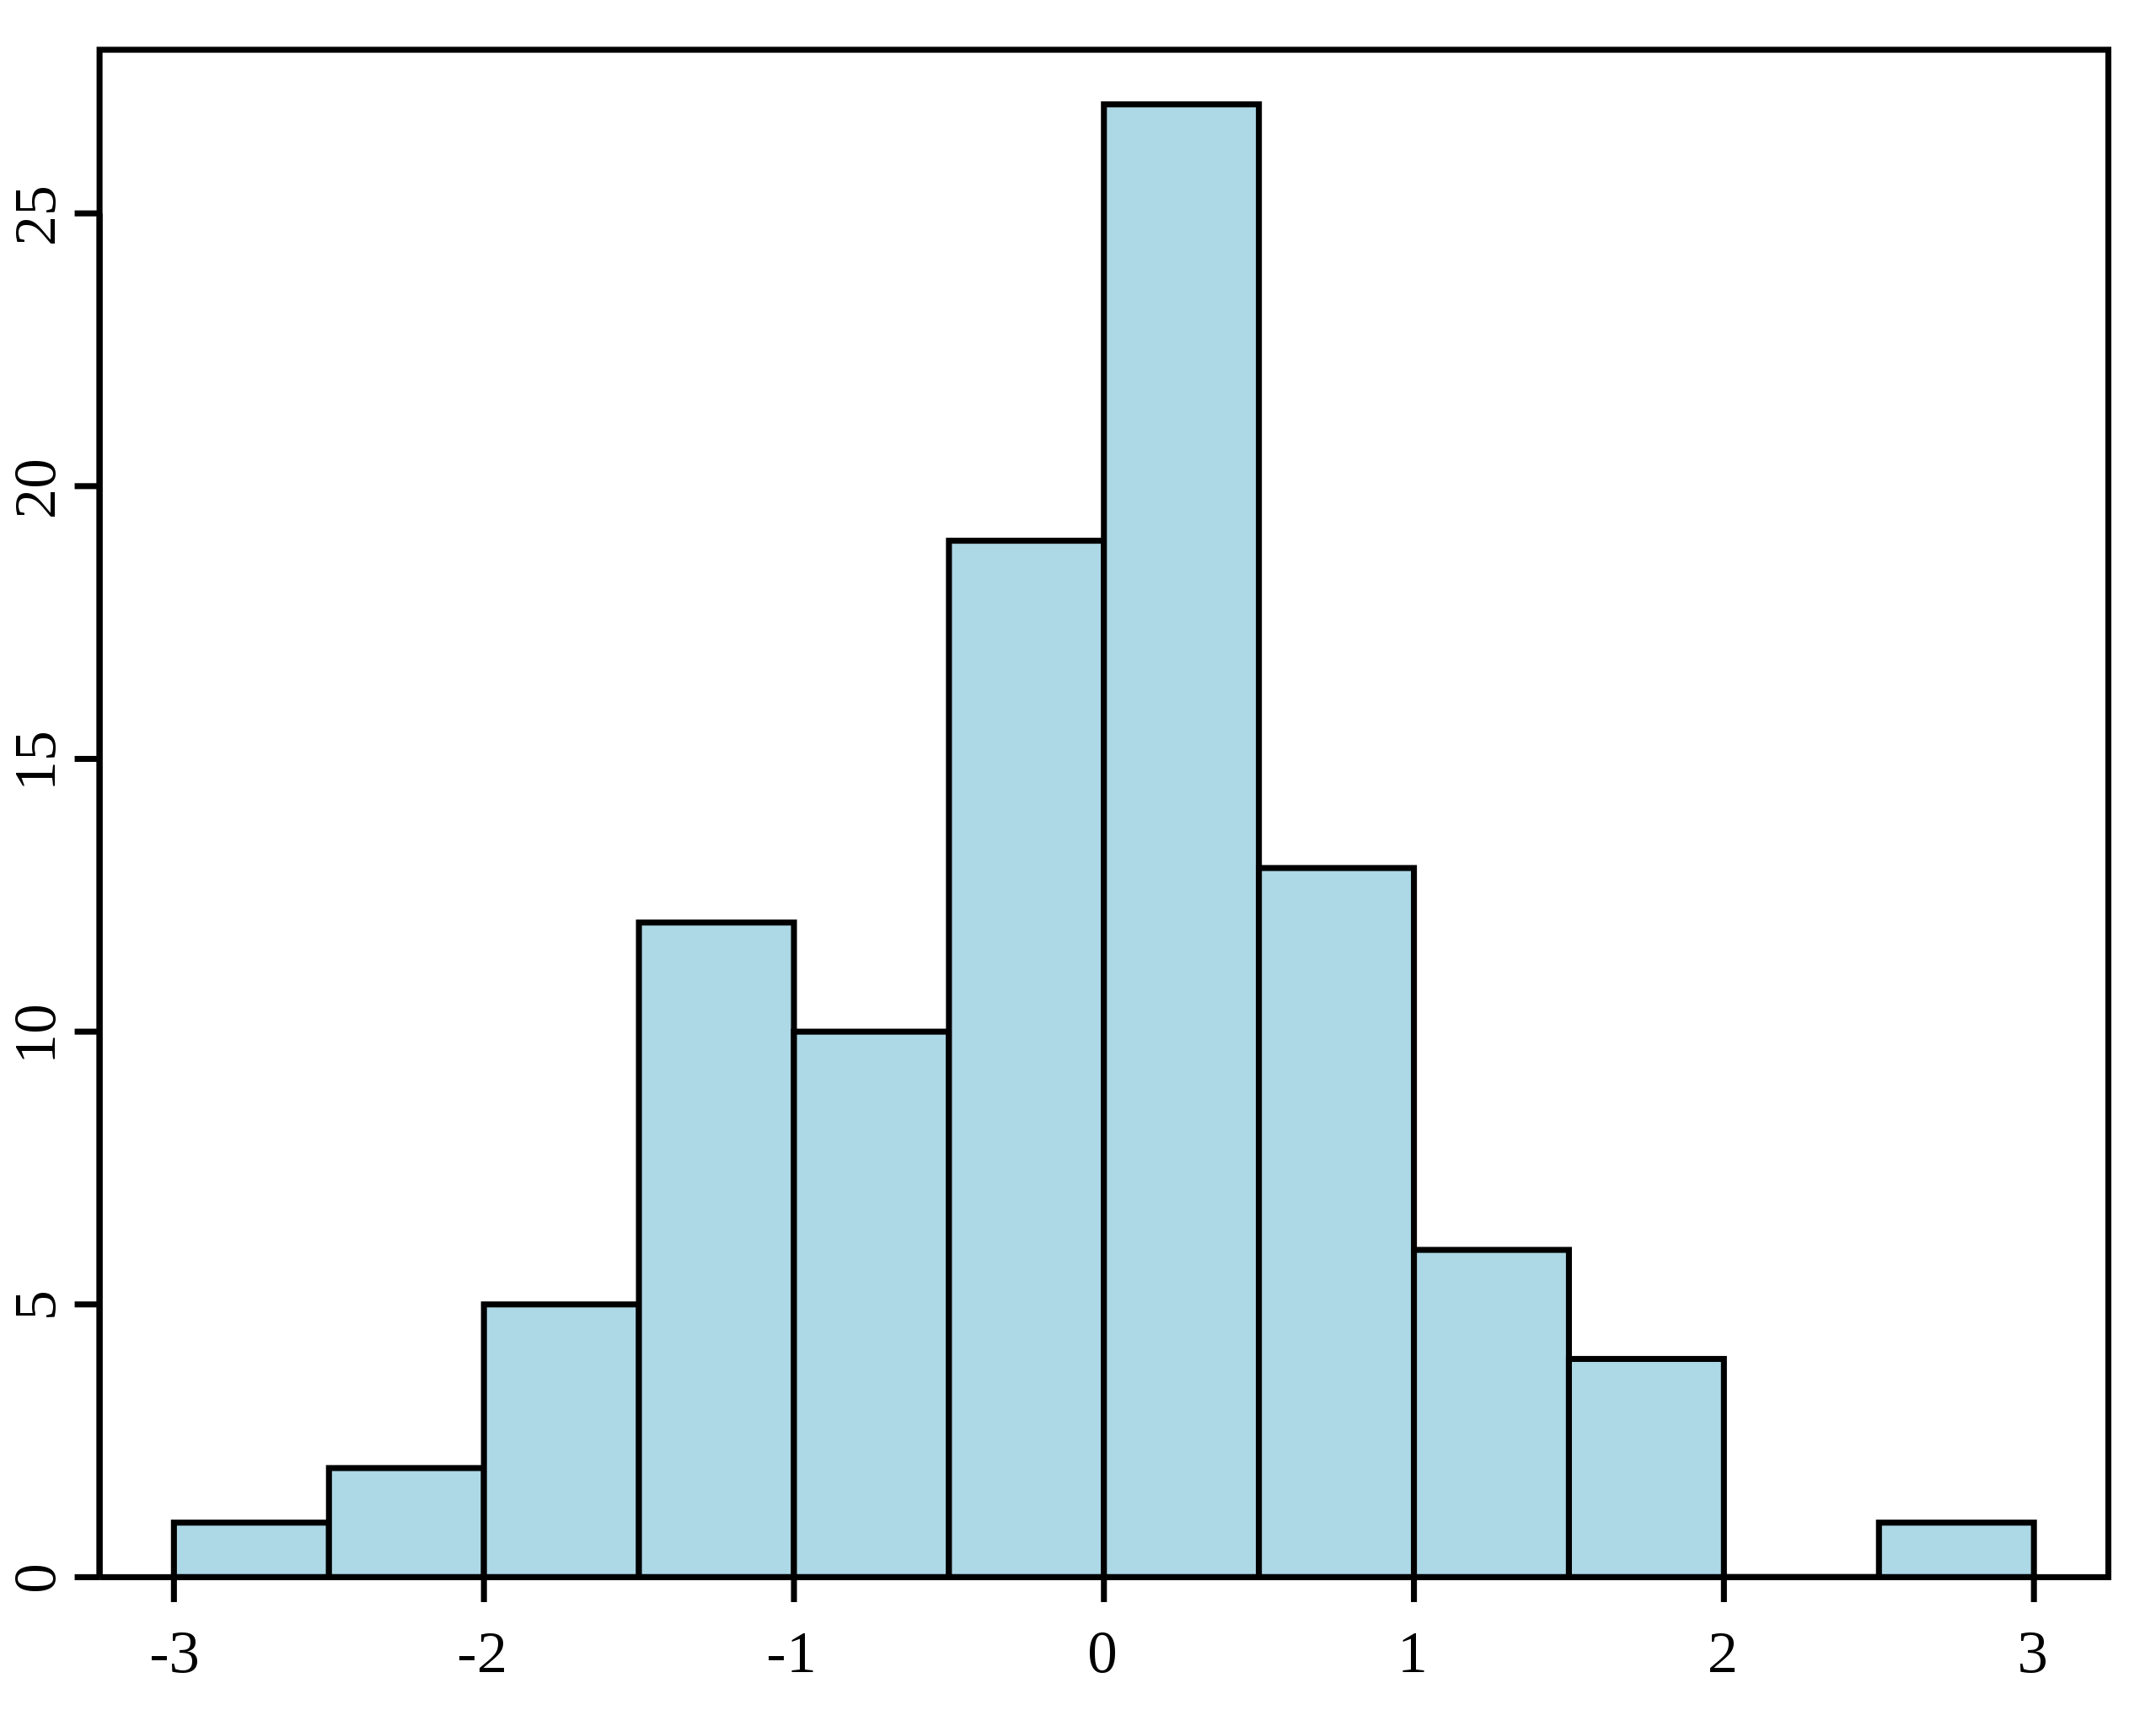
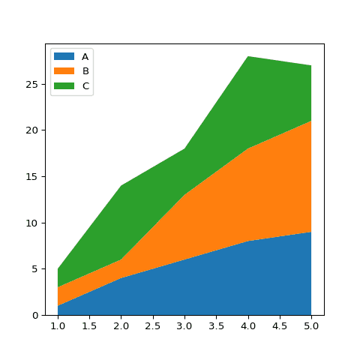
TYPES OF VISUALIZATIONS
Visualization types for showing data relationships
Univariate
Multivariate

Slide 19
Types of visualizations
Often necessary to transform our data for best/proper visualization of it
And you have already seen this with data preprocessing (e.g. numpy and pandas):
Normalization and Scaling
Probability distribution (transformation → distribution type and parameters)
One-hot encoding
TYPES

Slide 20
Types of visualizations: Bar plots and histograms
Example uses
Bar plot: Comparing buckets of things
Histogram: Viewing probability distribution of a variable
Bar plot
Histogram
TYPES

Slide 21
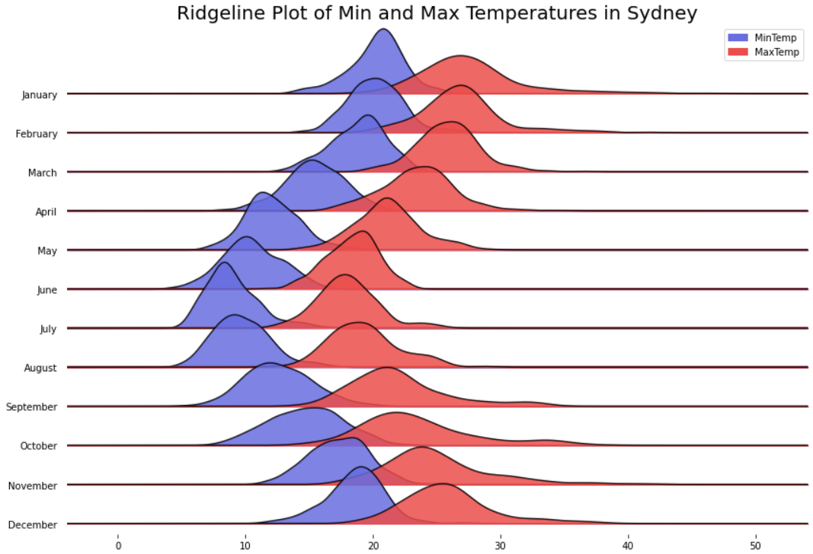
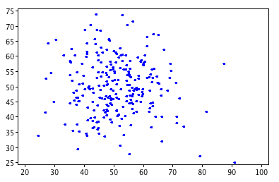
Types of visualizations: Scatter plots, line plots, Area plots
Example uses
Scatter plot: Cluster analysis
Line, area, and ridgeline plots: Uni- and multi-variate analysis
Scatter plot
Ridgeline plot
TYPES

Slide 22
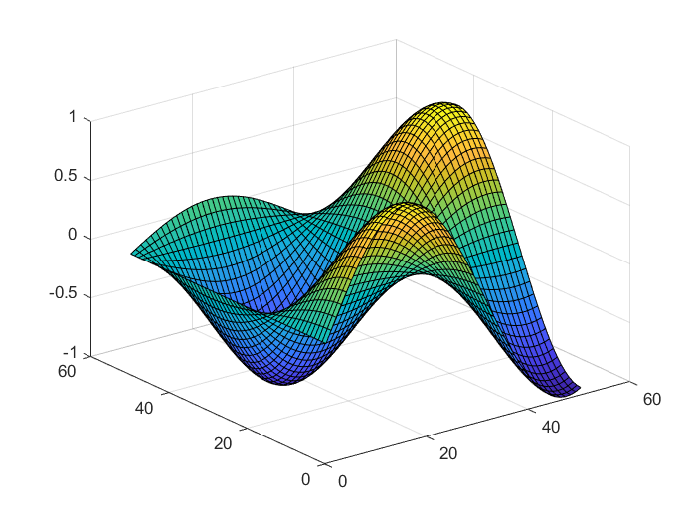
Types of visualizations: 3D surface plots
Example uses
Multivariate analysis
2D+ statistical distributions
TYPES

Slide 23
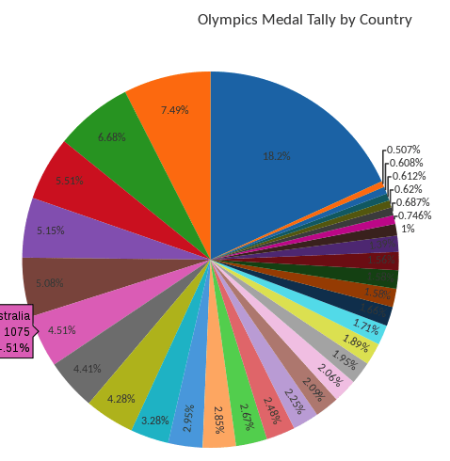
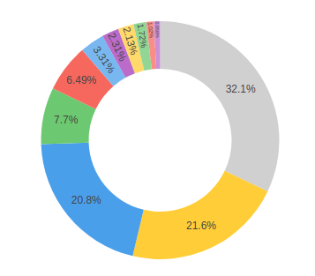
Types of visualizations: pies and TORUS
Recommended avoiding usage. However, clarity can be added via labels …
Pie
Torus (notice how removing middle increases clarity)
TYPES

Slide 24
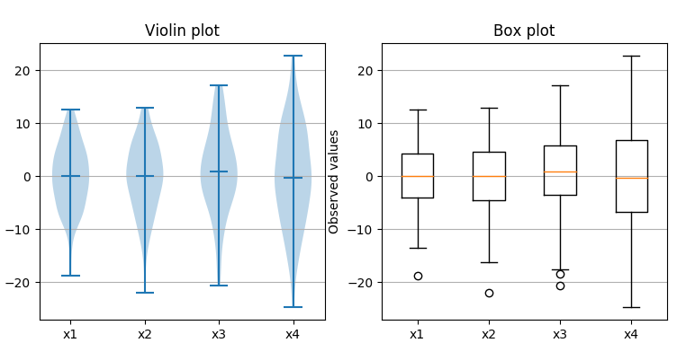
Types of visualizations: Box plots and violin plots
Example uses
Box plot – Alternate means of visualizing statistical distributions, summary statistics, quartiles
Violin plot – Visualizes more information about a distribution
TYPES

Slide 25
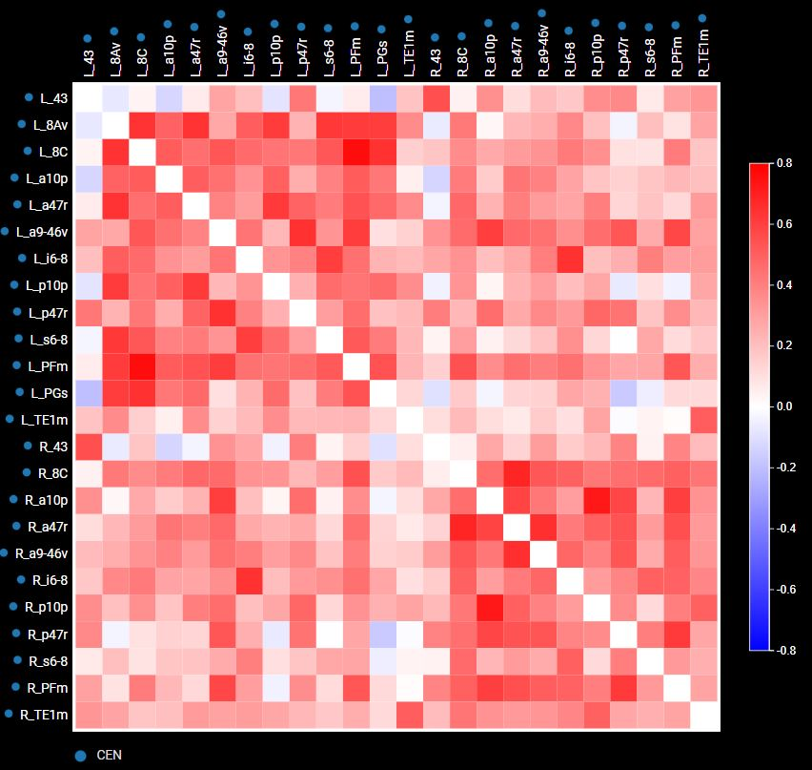
Types of visualizations: heat maps and correlation/connectivity matrices
Example uses:
Correlation coefficient between multiple features in a dataset
Connectivity strength between brain ROIs across a measurement
TYPES

Slide 26
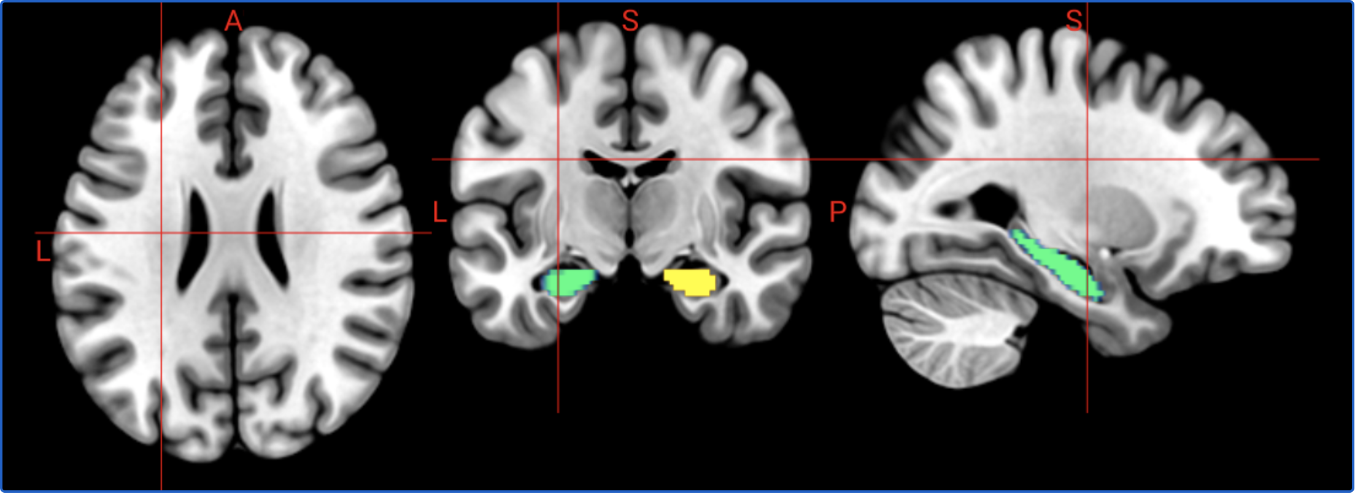
Last but not least… neuroimaging visualizations
Niivue
WebGL 2.0 NIfTI+ neuroimaging viewer – 2D and 3D!
Check out the many possible interactive views: https://niivue.github.io/niivue/
TYPES

Slide 27
Why interactive plots?
Viewer can select/deselect data within the plot to make new comparisons
Viewer can zoom in and out of graph
Can increases ability of viewer to verify claims made in your text
Interactivity heightens engagement with your research, drawing interest
Can increase comprehension of your research and findings

Slide 28
Learning how to learn Data Viz Libraries
Get familiar with data viz/graphing library API documentation
Know how to find the functionality you want, but being open to exploring what the library has to offer you – additional parameters, additional functionality
Memorizing functions is good, but not recommended. Libraries changes. More libraries and extensions of them are made frequently.
It’s good to stumble. And you will.
It’s more important to know what you would like to show and the kinds of visualizations available to you that can best show it.
LIBRARIES

Slide 29
matplotlib
One of the more low-level and richly-featured Python graphing libraries
One of the most historically used plotting libraries
Its pyplot uses a Matlab-like API.
Can output static images but also interactive plots
Like Numpy, it uses underlying libraries to efficiently process multidimensional data
LIBRARIES

Slide 30
Seaborn
Higher level graphing library built on matplotlib (typically less function calls)
Like matplotlib, uses pandas and numpy data types
Specifically geared toward making statistical graphics (linear regression, time series data)
Plot themes
LIBRARIES

Slide 31
BOKEH
Feature-rich, highly interactive, customizable
Python-based
Generates web-ready data visualizations
Funded by a non-profit with community support by researchers of all stripes
Build dashboards is somewhat tedious and with comparatively limited degree of interactivity
3D graphs via 3rd party extension
LIBRARIES

Slide 32
Plotly
Feature-rich, highly interactive, customizable
JavaScript-based with Python API
Also has programming language bindings in addition to Python (i.e. R and NodeJS)
Generates web-ready data visualizations that are easily shareable
Built by a private company with community support by/for researchers of all stripes
Has an array of extras: including a web-based editor, a lightweight version (Plotly express), and interactive, Python-based dashboard scripting for web apps (Plotly dash).
Simple syntax; easier to style; quicker to build dashboards
Has 3d graphs
LIBRARIES

Slide 33
And much, much More
GGPlot and Dplyr for R (plotnine in Python)
D3.js
Ready to go dashboard suites, i.e.Tableau
WebGL
See end of our exercises notebook for links and visualization lists!
LIBRARIES

Slide 34
The importance of design in visualization
Labeling, labeling, labeling
Please label axes and axis ticks (though sparely)
Clear graph titles that summarize their purpose and/or your perspective
Typefaces
Coordinate typefaces
Limit to 2-3 max. Two is good. Three is close to too many.
Spacing
Keep space between chart elements (including labels) where possible
Good spacing increases the clarity of visualizations
DESIGN

Slide 35
The importance of design in visualization
Color and Palette for Visualizations
Many times color is not available where a visualization will be featured
Convert a static, color graph to greyscale to see if colors are distinguishable
Switch to pattern fills where applicable
Design palettes that attempt to make it easy for those with various kinds of colorblindess to more easily distinguish between the palette’s colors
Avoid rainbow color palettes (a.k.a. ‘jet’)
DESIGN

Slide 36
The importance of design in visualization
Use a colorblind-friendly palette generator
Accounts for the different kinds of colorblindness (e.g. red-green and blue-yellow and their subvariants)
Ex. palett.es
DESIGN

Slide 37
Now it’s time to get our hands on some 🐍 visualization …

Slide 38
INSTRUCTIONS
Read through and run the cells of the part 1 data types notebook, and then move on to the part 2 exercises notebook when ready.
Remember, it’s good to stumble. If you really need help, raise your hand and I or someone else knowledgable with these Python graphing libraries will attempt to assist.
If you need a break, feel free to browse through the visualization API links and visualization lists.

